Slide 1
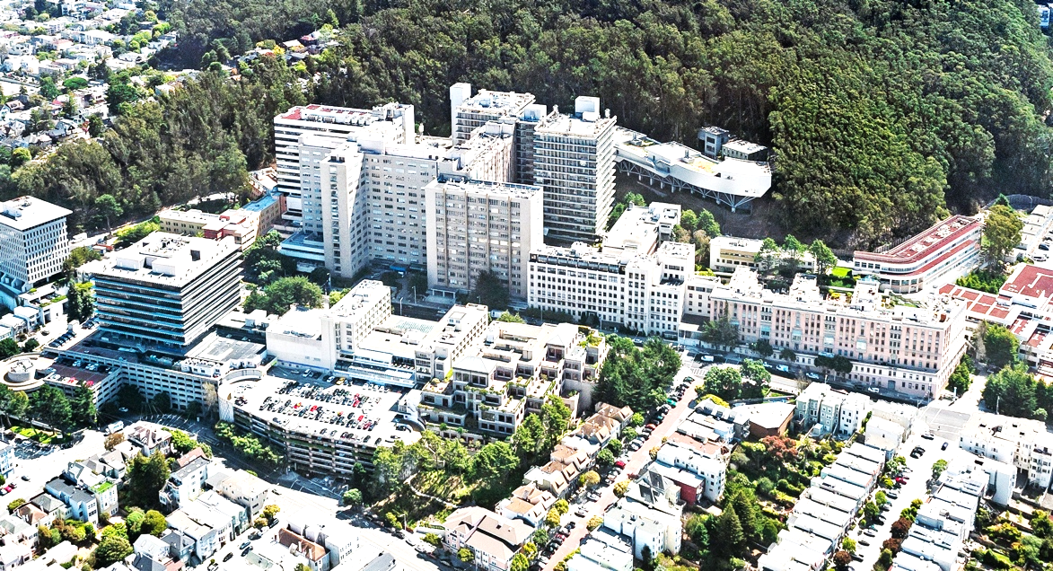

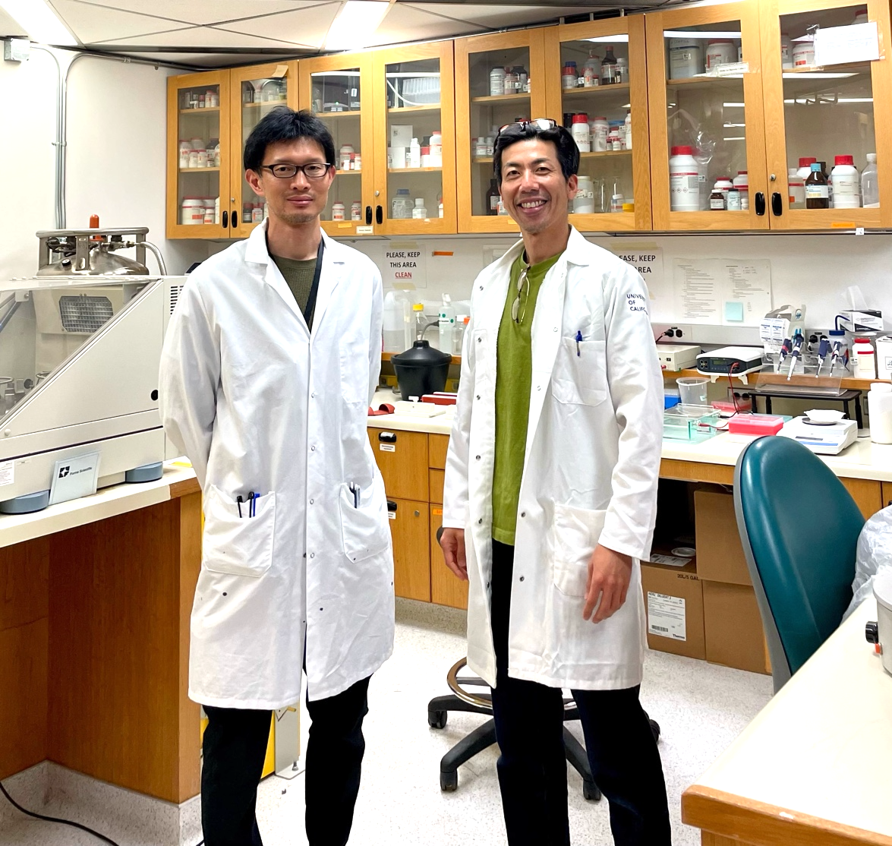
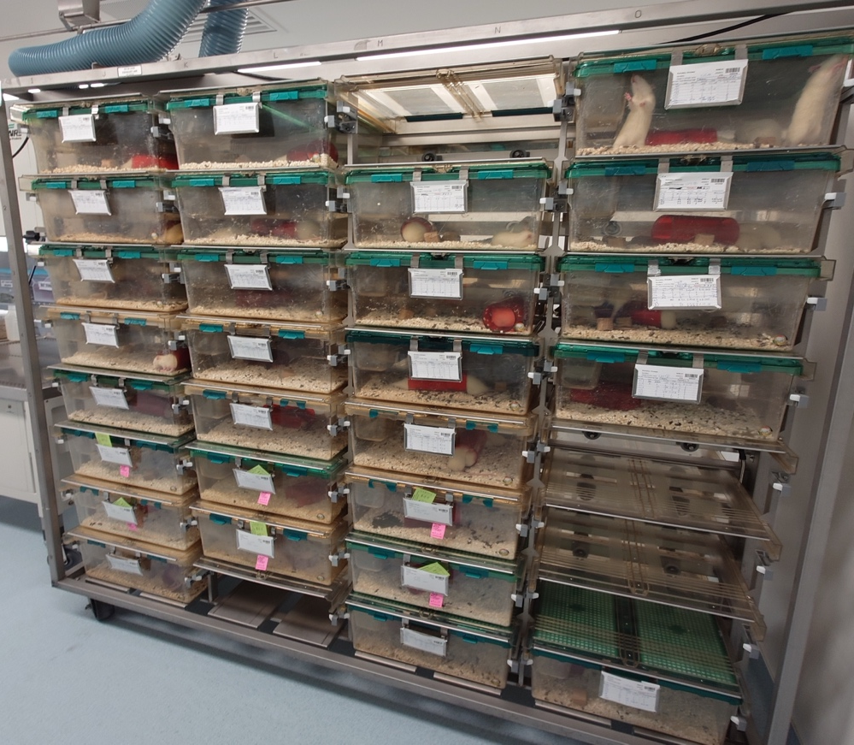
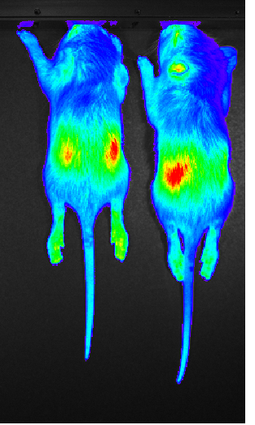
Luc-Tg rats expand tissue engineering research in US
Komatsu Lab at UCSF
Selected Publications from Komatsu Lab using Luc-Tg rats
Kobayashi et al., 2024, Cell Transplant Gonzalez et al., 2023, Cell Transplant Myrick et al., 2022, Biofabrication Komatsu et al., 2022, Pancreas Komatsu et al., 2021, Mol Imaging Biol Komatsu et al., 2020, Microvasc Res Komatsu et al., 2020, Transpl Int Cook & Komatsu et al., 2019, Actuators & Microsystems Komatsu et al., 2018, Biofabrication
Drs. Mitsugashira (Lt) and Komatsu (Rt)
We are breeding Luc-Tg rats in our animal facility, originally developed in 2006 by Dr. Eiji Kobayashi (Hakamata et al., Transplantation). Dr. Komatsu has been using Luc-Tg rats since 2014 at City of Hope Medical Center (Los Angeles) and brought them to UCSF in 2024. These rats are now actively used for cell and organ transplantation research.
Notes:
2025-0919 Lab meeting Hiro3

